Slide 1

Cheminformatics Introduction
Jeremy Yang
Associate Instructor IU School of Informatics and Computing
Instructor: Prof. Joanne Luciano
DATA SCIENCE FOR DRUG DISCOVERY, HEALTH AND TRANSLATIONAL MEDICINE (DSDHT) INFO I-590

Slide 2



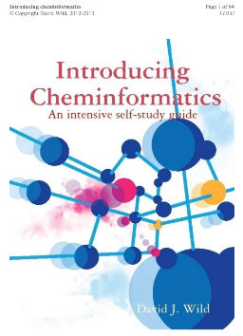

Cheminformatics: Introduction

Slide 3
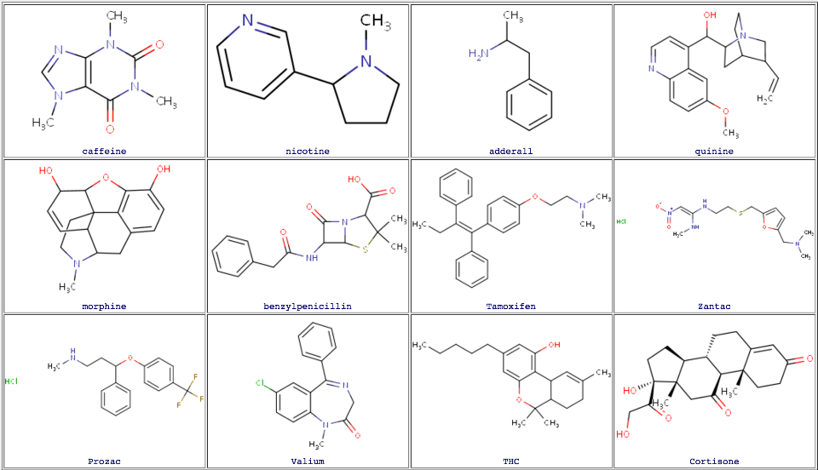
Cheminformatics: What makes drugs so special?

Slide 4
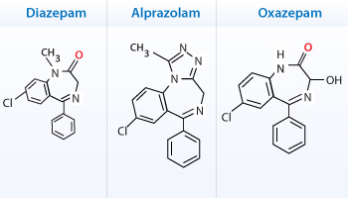
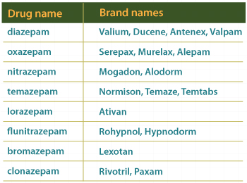
Cheminformatics: Chemotypes
Benzodiazepines class of tranquilizers sharing a common ring system, a pattern, chemotype or scaffold.
Similarity principle: similar chemicals, bioactivity.
Representing chemicals as molecular graphs enables efficient storage and analysis.
From https://www.wonderwhizkids.com/conceptmaps/Tranquilizers.html

Slide 5
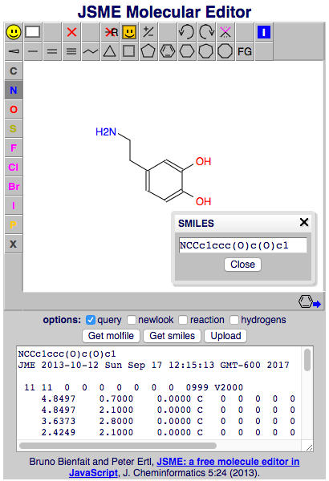
Cheminformatics: Representing molecules computationally
molecular depiction (2D)
SMILES (Simplified Molecular
Input Line Entry System)
molfile (connection table)
http://pasilla.health.unm.edu/jsme.html

Slide 6
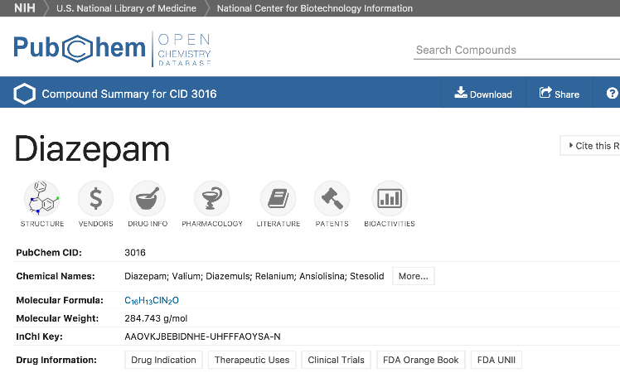
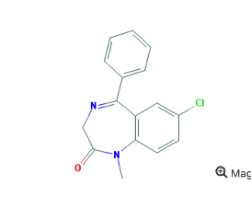
Cheminformatics: Chemical databases
"PubChem, released in 2004, provides information on the biological activities of small molecules."
https://pubchem.ncbi.nlm.nih.gov/

Slide 7
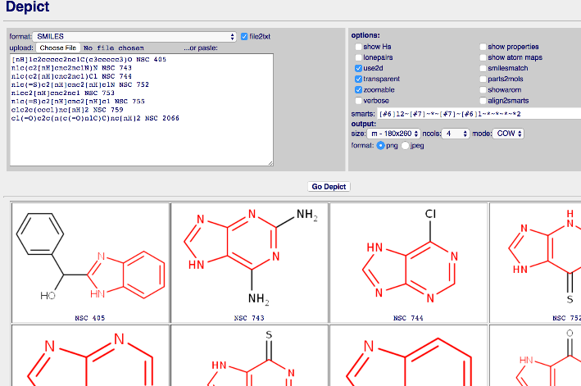
Cheminformatics: Chemical patterns
Imidazole pattern subgraph matching with SMARTS.
[#6]12~[#7]~*~[#7]~[#6]1~*~*~*~*2
SMARTS = Smiles Arbitrary Target Specification (akin to regexp)
http://pasilla.health.unm.edu/tomcat/biocomp/depict

Slide 8
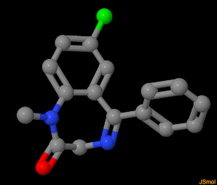
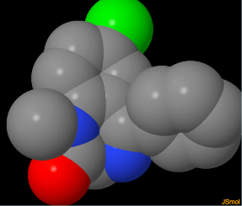
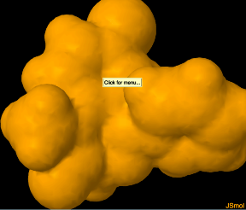
Cheminformatics: Molecules in 3D
ball and stick
spacefill
VDW surface
Drug bioactivity is related to 3D properties and interactions.
Display by JSMol http://jmol.sourceforge.net/
Conformation by RDKit, http://www.rdkit.org/

Slide 9
Cheminformatics: Glossary
small molecule | not a protein or nucleic acid (macromolecule)
pharmacology | study of uses, effects and modes of action of drugs
bioactivity | effect of a chemical on a biological target
IC50, EC50 | measures of bioactive potency
structure-activity relationship | bioactivity vs. structural features within a chemical series
molecular descriptor | measured, theoretical or computed property
substructure searching | searching for molecular subgraphs
similarity searching | searching for similar molecules
pharmacophore | 3D features pattern interacting with a binding site
molecular modeling | computational models, 2D, 3D and statistical, for explaining, visualizing and predicting
computational chemistry | connotes physics-based modeling, molecular mechanics and dynamics, etc.
virtual screening | in silico search (assay) for bioactive candidates

Slide 10
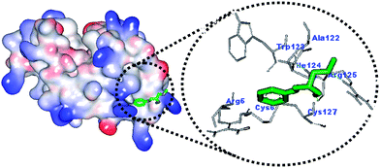
Cheminformatics: Modeling protein-ligand binding
AutoDock is a suite of automated docking tools. It is designed to predict how small molecules, such as substrates or drug candidates, bind to a receptor of known 3D structure.
AutoDock is one of several tools for docking and modeling protein-ligand binding.
http://autodock.scripps.edu/

Slide 11
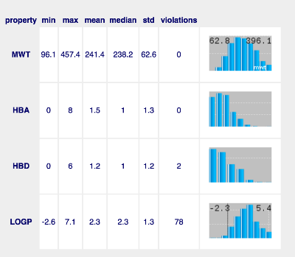

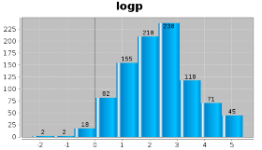
Cheminformatics: Drug-likeness and lead-likeness
The Lipinski Rule of Five (Ro5) was formulated by Christopher A. Lipinski and published in 1997, and is intended to guide library selection for drug discovery. The following molecular descriptors are used:
mwt - avg molecular weight
hbd - hydrogen bond donor count
hba - hydrogen bond acceptor count
LogP - octanol-water partition coefficient
The Ro5 specifies that compounds should violate no more than one of the following criteria:
mwt <= 500
hbd <= 5
hba <= 10
LogP < 5.0
http://pasilla.health.unm.edu/tomcat/biocomp/ro5

Slide 12
Cheminformatics: Drug discovery applications
Databases of relevant compounds and metadata
2D virtual screening (substructure, similarity)
3D virtual screening (shape, pharmacophores)
Property prediction (e.g. solubility, logP)
ADMET prediction (absorption, distribution, metabolism, excretion, toxicity)
Clustering (unsupervised ML)
Quantitative structure-activity relationship modeling (QSAR)
Modeling/predicting protein-ligand binding
De novo design (e.g. GAs)

Slide 13
Cheminformatics: Take home messages
Understanding the structure and properties of chemicals enables us to explore biological effects and discover new drugs.
Chemical databases provide access to a wealth of biomedical and drug discovery data, searchable via cheminformatics.
In silico predictive modeling accelerates and economizes early stage drug discovery.

